Slide 1

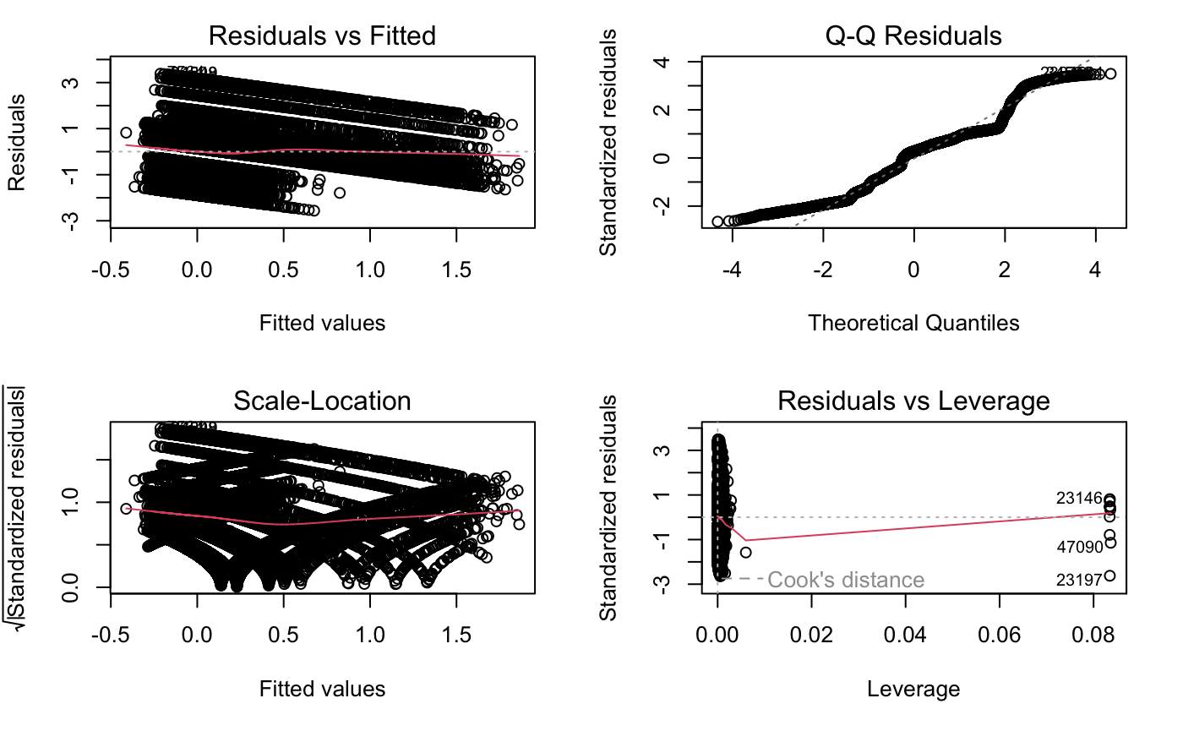
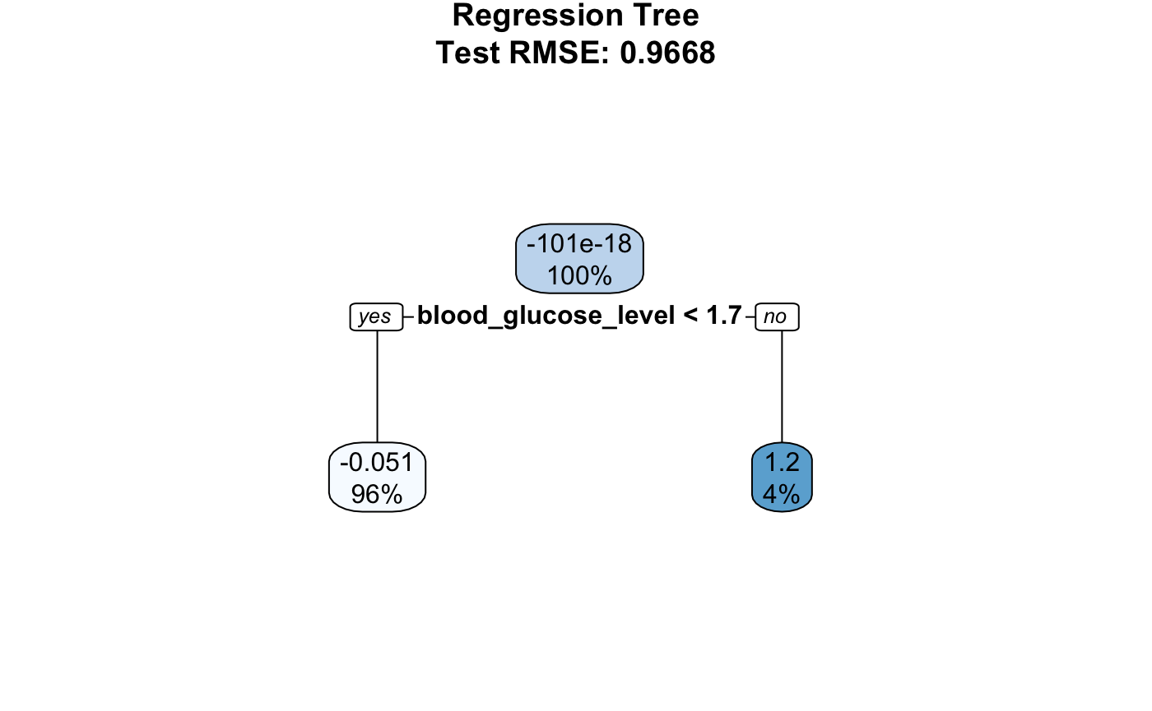
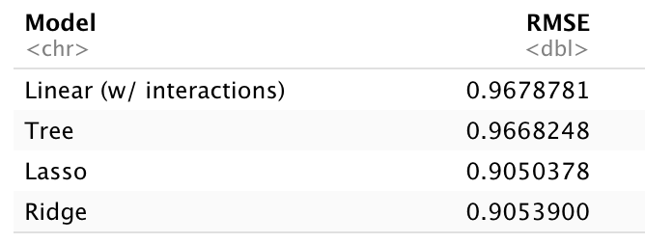
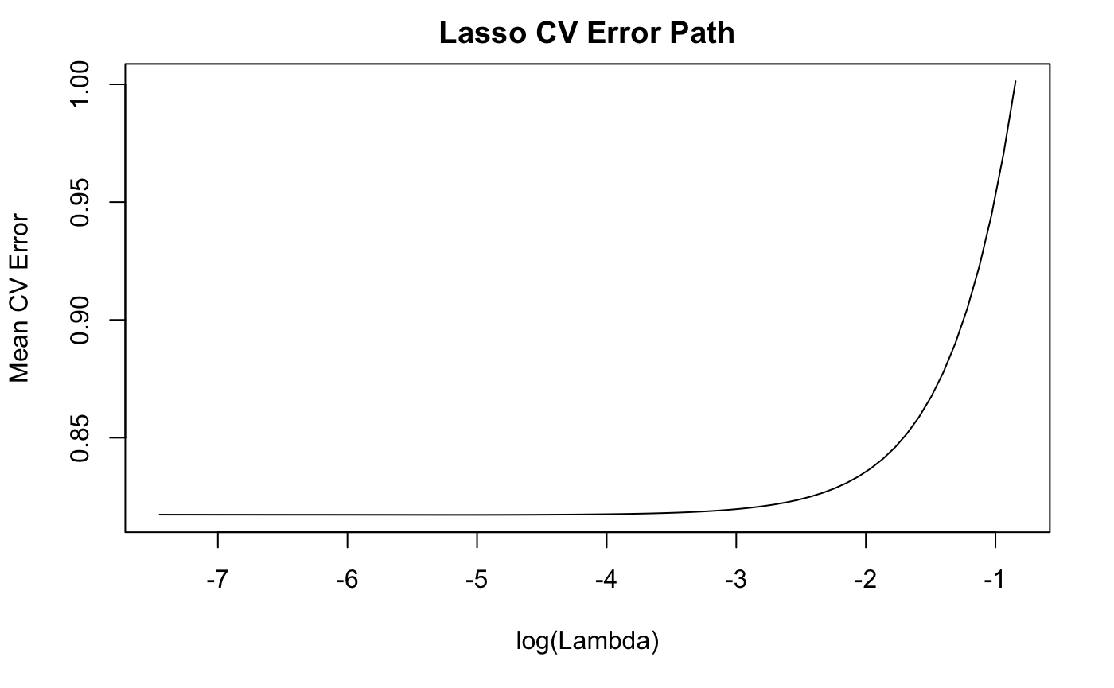
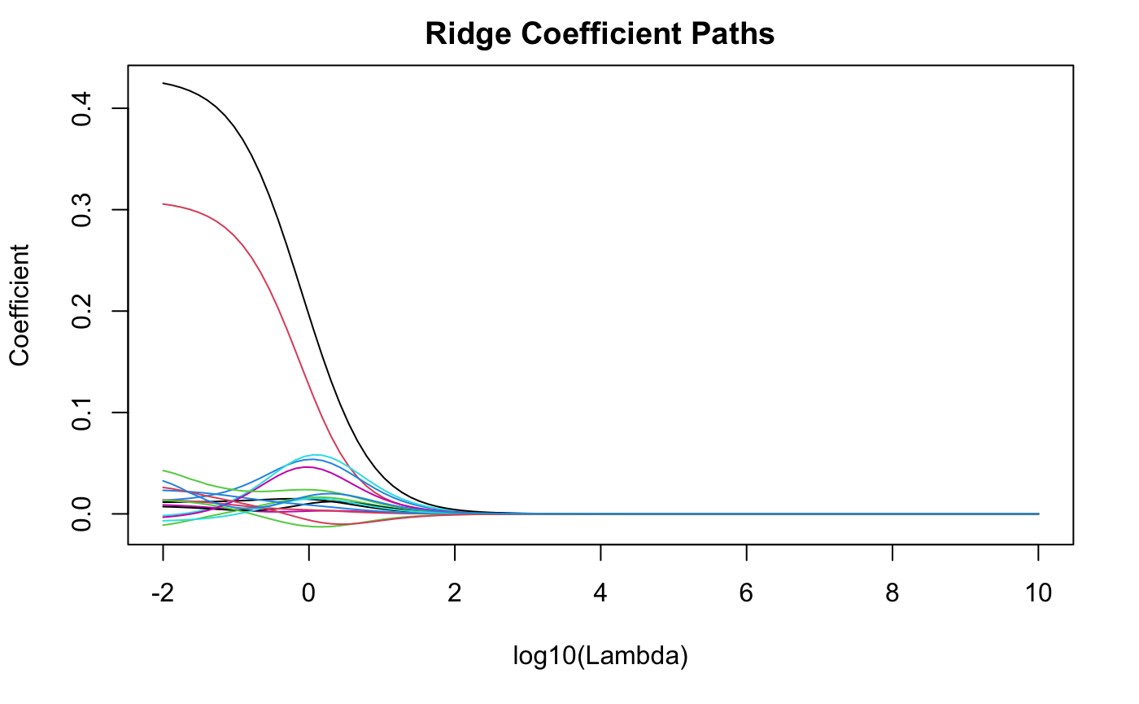
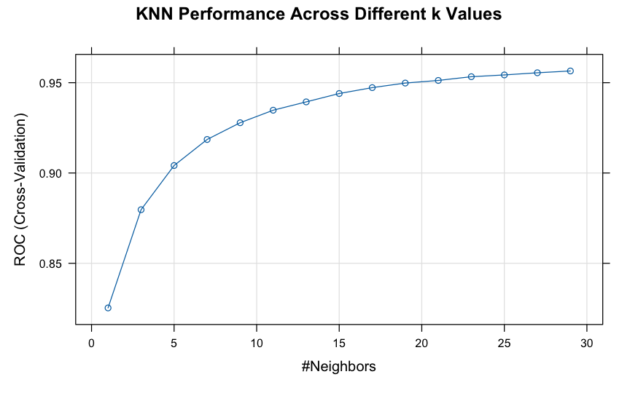
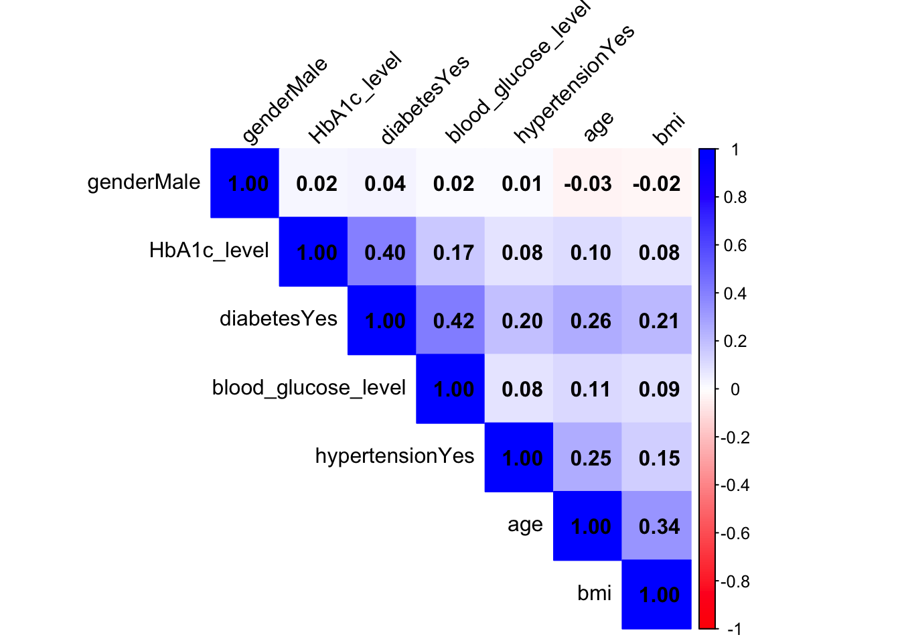
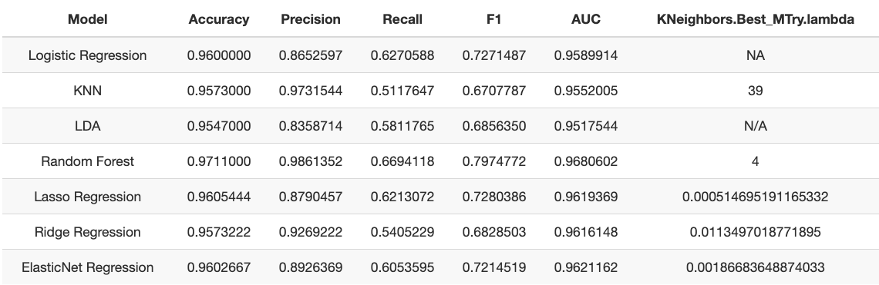
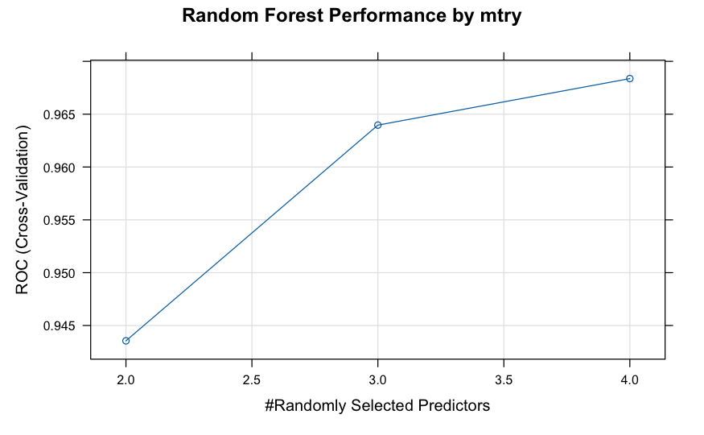
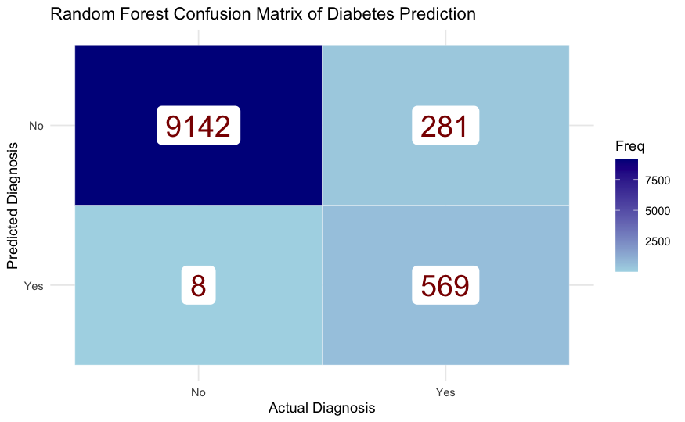
Predicting HbA1c Levels and Type II Diabetes Diagnosis with Demographic, Biometric, and Medical History Data
Thaina Gomez & Maxwell Miller-Golub STAT 627 – American University
Introduction/Context
Type II diabetes affects over 10% of adults, with nearly half undiagnosed [1]. Early detection is critical for preventing complications. Even after accounting for health insurance, immigrants and racial/ethnic minority adults have increased odds of undiagnosed diabetes [2].
RO1: Investigates whether demographic and biometric factors can predict HbA1c levels.
RO2: Cross-examines different classification models to determine the best method for accurately attributing Diabetes diagnosis
Executive Summary
Type II Diabetes impacts over 10% of adults, with nearly half undiagnosed. Racial and ethnic minorities are disproportionately impacted. Identifying key risk factors may lead to increased diagnoses and longer life expectancy. Utilizing various biometric and demographic features, we found:
Regression models (Lasso & Ridge) returned RMSE values of 0.905 while predicting HbA1c, a key diabetes indicator
A Classification model (Random Forest) which has 97% accuracy at correctly predicting diabetes diagnoses on unseen cases
RO1: Demographic/Biometric Features vs HbA1c levels
Diagnostic plots and visuals highlighted the need for interactions and non-linear terms.
Lasso & Ridge (RMSE = 0.905) captured complex patterns more effectively than the linear model.
Results/Implications
Even a simple model using routine health data can support early risk detection.
RO1: Lasso Regression had the lowest RMSE at 0.9050. Ridge followed closely behind. LM underperformed, despite including interaction & polynomial terms.
RO2: With our best model (Random Forest), an unseen case has a 97% chance of an accurate diabetes diagnosis.
Approach
Cleaned and explored a dataset (n = 100,000) with predictors: age, gender, BMI, glucose, hypertension, heart disease, and smoking history.
RO1: The data was split 80-20 train-test to evaluate model performance. We built four regression models to predict HbA1c levels: Linear regression w. interaction term, regression tree, Lasso regression, and Ridge regression. We standardized numeric predictors for Lasso/Ridge, and used 10-fold CV to select the optimal λ. For the linear model, we checked assumptions of linearity, independence, and constant variance, and assessed multicollinearity using VIF.
RO2: With “Diabetes” diagnosis as the target variable, we conducted a 90-10 train-test split with 10-fold CV in the training set. This led to Confusion Matrices for the following models: Logistic, Lasso, Ridge, and ElasticNet Regressions, KNN, LDA, and Random Forest.
RO2: Finding best Classification Model for Diabetes diagnosis
ANOVA determined all variables relevant in modeling
Random Forest (m = 4, trees = 500) led to every highest metric
Assumptions/Limitations/ Challenges or Secondary Results
RO1: RF and Gradient Boosting were not explored, and capturing complex relationships in the data could have provided better accuracy.
RO2: SVM, PCA/PCS not explored, though they may produce more accurate/efficient models.
Both: Dataset limited in scope and may not represent all demographics equally.
Future work should include more predictors (e.g., diet, physical activity). As medical data becomes more robust, more interesting and surprising relationships will be discovered.
Primary References
International Diabetes Federation. (2021). Diabetes facts & figures. https://idf.org/about-diabetes/diabetes-facts-figures/
Loretta Hsueh, Wei Wu, Adam T. Hirsh, Mary de Groot, Kieren J. Mather, Jesse C. Stewart. Undiagnosed diabetes among immigrant and racial/ethnic minority adults in the United States: National Health and Nutrition Examination Survey 2011–2018. Annals of Epidemiology, 51: 14-19, 2020.
Boye, K. S., Lage, M. J., Shinde, S., Thieu, V., & Bae, J. P. (2021). Trends in HbA1c and body mass index among individuals with type 2 diabetes. Diabetes Therapy, 12(7), 2077–2087. https://doi.org/10.1007/s13300-021-01084-0
Rohlfing, C. L., Wiedmeyer, H.-M., Little, R. R., England, J. D., Tennill, A., & Goldstein, D. E. (2002). Defining the relationship between plasma glucose and HbA1c: Analysis of glucose profiles and HbA1c in the Diabetes Control and Complications Trial. Diabetes Care, 25(2), 275–278. https://doi.org/10.2337/diacare.25.2.275
Data
Mustafa, M. (n.d.). Diabetes prediction dataset. Kaggle. Retrieved March, 2025, from https://www.kaggle.com/datasets/iammustafatz/diabetes-prediction-dataset
Size: 100,000 patient records Scale: Demographics, biometric info (age, BMI, blood glucose), and medical history (heart disease, hypertension, smoking)
Acknowledgments
Professor Ahmad Mousavi, STAT 427/627-001 Spring 2025

